Slide 1
Lecture 7: System (Integration) Testing and Test Automation
Gregory Gay
DIT636/DAT560 - February 9, 2026

Slide 2
Testing Stages
API
GUI
CLI
We interact with systems through interfaces.
APIs, GUIs, CLIs
Systems built from subsystems.
With their own interfaces.
Subsystems built from units.
Communication via method calls.
Set of methods is an interface.
API
API
Notes:
Previously, we started to talk about how systems are structured and how that affects testing. As we discussed, we can break testing into independent stages that we stagger throughout the development process. These stages are largely built around different levels of granularity within the system under test. If we look at the system from the outside, it looks like this box. It has interfaces - maybe a GUI, maybe an API, maybe some kind of command line interface. However, there is also a lot going on inside. (click). The system as a whole tends to be architected, as we saw, as a set of larger indepedendent subsystems. Each of these has their own interface, and the subsystems communicate with each other through those interfaces. (click) then, within those, we have a bunch of individual, standalone UNITS (classes), all working together to produce the functionality offered by that subsystem, by calling methods in the other classes when needed - with methods forming another kind of interface. We need to test at all of these levels - class (or unit), subsystems, and the system as a whole.

Slide 3
Testing Stages
API
GUI
CLI
System-level Testing
Tests whole system or independent subsystems through an interface.
Integrates lower-level components
(Subsystem-level) Does unit collaboration work correctly?
(System-level) Does subsystem collaboration work correctly?
API
API
Notes:
We previously talked about unit testing, and now we step up the ladder to system testing, where we (2). These test cases examine the integration of the lower-level elements of the system. Most software works by combining multiple, interacting units, within multiple interacting subsystems. In addition to testing units independently, we must test their integration. Then, when the individual subsystems work in isolation, we bring them together again and test the integration of the subsystems. At the subsystem level, we bring low-level units together - classes which may have been tested independently and now we test their integration with each other - can they work together without breaking everything? Even if we’ve tested the individual units, faults can emerge from their combination, so we integrate the units together and test their combination and whether the subsystem as a whole can perform the functions that we stated in the specification. At the full system level, we integrate these independent elements of the architecture to form a full system and we test the combined system to ensure that therre aren’t errors in the user-facing functionality. Functionality performed across units is accessed through a defined interface.This can be through any way of interacting with the component of interest. A graphical interface, a command line interface, an API that we send requests to, through message passing, or even by calling methods. integration testing focuses on showing that functionality accessed through this interface behaves according to the specifications.

Slide 4
Unit vs System Testing
Unit tests focus on a single class.
Simple functionality, more freedom.
Few method calls.
System tests bring many classes together.
Focus on testing through an interface.
One interface call triggers many internal calls.
Slower test execution.
May have complex input and setup.
Notes:
Unit tests focus on a single class. This is very important and hard to get right, but still There is a limit to how complex one class can be, so as a result, unit tests tend the be small, and you can quickly write a lot of them. You will write a lot of them, as you can access a class and prod it in ways that you can’t when working through an interface - you can easily set variable values, for example. Unit tests, because they are simple, execute quickly. System tests, of course, focus on the system as a whole, or at least a large subsystem - a large set of classes accessed through an interface. System tests bring many underlying classes togehther. The interface constrains how you test, but testing is done on high-level functions that require the interaction of many low-level components. The tests often require more complex input, more complex setup procedures, and complex series of events. They trigger many internal system calls and interactions, so they also are much slower to execute and it may be harder to debug when something goes wrong as oyu need to trade the source of the failure to any number of places.

Slide 5
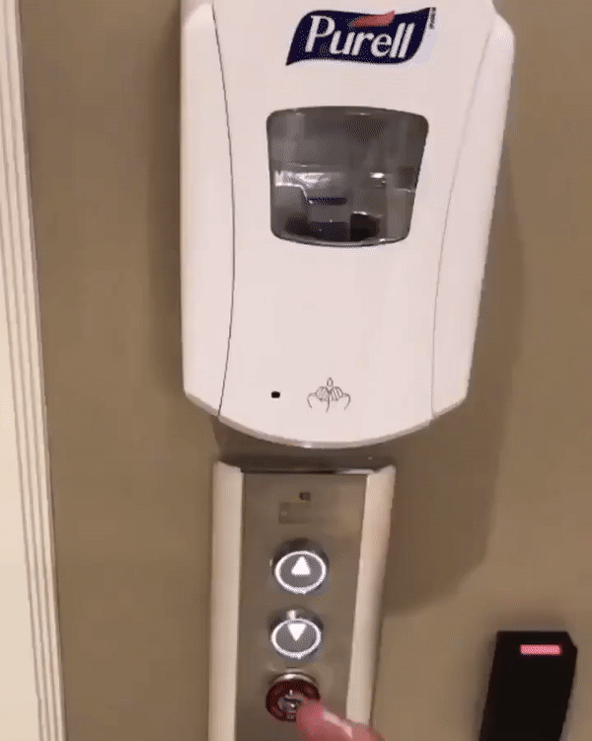
System Testing
System components are expected to interact.
Usually this is planned!
Sometimes unplanned interactions break the system.
We should select tests that thoroughly test component integrations.
Notes:
Why do we do this? The internal components of your software do not exist in a vacuum. These components - classes, subsystems, services- interact in various ways, both in positive and intended ways, but also in critical and unplanned ways. Components are often expected to interact: to exchange information, to determine the behavior of other features, reuse the functionality of other components, and accomplish a task in cooperation. Unit testing ensures they work on their own, but we isolate the units when we do that. We mock method calls to other classes, and assume everything works as expected in the dependencies. We can’t easily notice faults in their combined behavior. However, inadvertent interactions - ones where there are faults or misunderstandings in how the units combine- can cause unexpected and incorrect behaviors. Detecting and resolving unintended component interactions is one of the key challenges of developing a complex system - and a major point of integration testing- and we want to design our test cases to examine critically important component integrations and have a high chance of detecting these mistakes in the interactions.

Slide 6

Fire and Flood Control
Fire Control activates sprinklers when fire detected.
Flood Control cuts water supply when water detected on floor.
Interaction means building burns down.
Notes:
As an example, In a building-automation system, feature FireControl activates sprinklers when sensors detect a fire, and feature FloodControl cuts off water supply when water is detected on the floor. Individually, both features operate as desired, but they interact in inadvertent and critical ways: When fire is detected, feature FireControl activates sprinklers; sub- sequently, feature FloodControl detects standing water, and turns off the water main; as a consequence, the building burns down. Clearly, the interaction between FireControl and FloodControl is undesired, and inadvertent in the sense that it is hard to predict when planning and implementing the involved features independently. Only when the interaction is known, we can take corresponding steps to manage or resolve it, in this case, for example, by giving explicit priority to feature FireControl over feature FloodControl, controled by some coordination code.

Slide 7
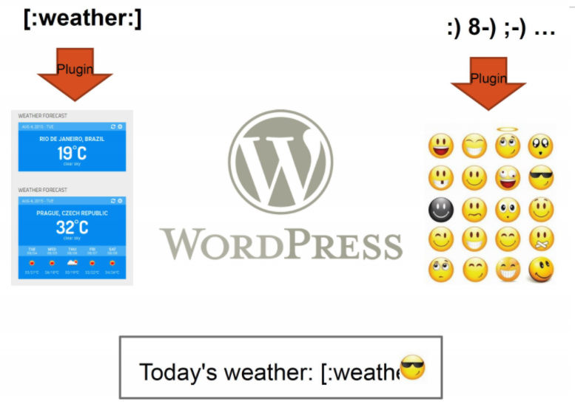
WordPress Plug-Ins
Weather and emoji plug-ins tested independently.
Their interaction results in unexpected behavior.
Notes:
Or, consider WordPress plug-ins. We have a plug-in that turns symbols into emoji. We also have a plugin that lets us insert a forecast widget into a post. Weather is activated using [:weather:]. However, :] is also an emoji. In isolation, each works really well. Each has been fully tested, and works as expected. When we combine them, we get unexpected behavior. The emoji plug-in activates first, turning :] into a smiling emoji. This then breaks the weather plug-in because it no longet sees the weather command. If the ordering was reversed, it would work just fine. However, these two plug-ins were developed independently and never tested together - why would they be? As a result, we get an unexpected interaction.

Slide 8
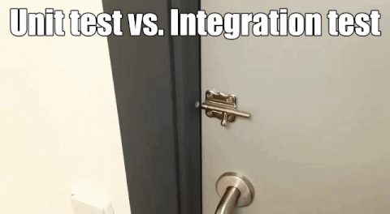
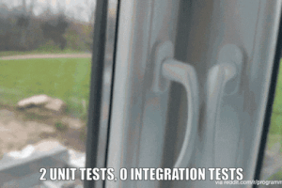
Component Interactions
Notes:
A lot of memes, right? These illustrate pretty succinctly how components can interact in unexpected ways even after you test each in isloation. On the left, a perfectly functional door lock on a perfectly functional sliding door. In isolation, great. Combined, that lock doesn’t do a bit of good. On the right, two windows. Each would work on their own, but in combination, they block each other. This illustrates why unit testing is crucially important, but so is system-level testing.

Slide 9
Interface Types
Parameter Interfaces
Data passed from through method parameters.
Subsystem may have interface class that calls into underlying classes.
Procedural Interfaces
Interface surfaces a set of functions that can be called by other components or users (API, CLI, GUI).
Integrates lower-level components and controls access.
Notes:
When I say interface, I mean that we have some clearly defined way to access the functionality offered by the code at the level of granularity we are testing at - a class, a subsystem, or the system as a whole.
How this code can accessed from the outside. There are four main types of interfaces that we are concerned with. First are parameter interfaces. This is a code-level construct. A set of methods that are public, and that are appropriate for accessing the code we are interested in testing. A parameter interface is a set of one or more methods called by code, where we pass information through the method arguments. All classes have a parameter interface. Many times, a “subsystem” is not an indepedent executable, but just a set of classes we have roped off, that are accessed through a specially designated class that we call. This is a parameter interface to that subsystem, and we should test that subsystem through different parameter combinations to those methods. Second is a procedural interface, where one component encapsulates a set of functions that can be called by other components. That is, it offers an API, CLI, or other dedicated interface surfacing a few high-level functions. This interface controls access to subsystem functionality. Thus, is important to test rigorously, as these high-level functions will integrate several underlying components - classes or subsystems togetehr.

Slide 10
Interface Types
Shared Memory Interfaces
A block of memory is shared between (sub)systems.
Data placed by one (sub)system and retrieved by another.
Common if system architected around data repository.
Message-Passing Interfaces
One (sub)system requests a service by passing a message to another.
A return message indicates the results.
Common in parallel systems, client-server systems.
Notes:
In a shared memory interface, A block of memory is shared between components. the different subsystems don’t talk directly, but instead make changes to and read from a central data source or block of dedicated memory.Data is placed in this memory by one subsystem and retrieved by another. The different elements may not communicate directly, but their behavior is influenced by the state of the data. Common if system is architected around a central data repository. This is a form of interface that must be tested by manupulating this data. Finally, we might have Message-Passing Interfaces where one component requests a service by passing a message to another component. A return message indicates the results of executing the service. Common in parallel systems, client-server systems. Common when you have multiple processes that need to synchronize from time to time, but mostly run independently and can’t be expected to immediately respond to a method call.

Slide 11
Interface Errors
Interface Misuse
Malformed data, order, number of parameters.
Interface Misunderstanding
Incorrect assumptions made about called component.
A binary search called with an unordered array.
Timing Errors
Producer of data and consumer of data access data in the wrong order.
Notes:
Interface errors are one of the most common forms of error in complex systems. These usually fall into three types. (1) A calling component calls another component and makes an error in the use of its interface, in how it is called. This might be wrong type or malformed data passed to a parameter, parameters passed in the wrong order, wrong number of parameters input. (3) Incorrect assumptions made about the called component. So, as a result, the behavior returned from the called component was not what was expected, causing the wrong outcome from the calling component. An example of this might be if you called a binary search from a component and fed it an unordered array. Well, binary search assumes you’ve already sorted the array, so it will return the wrong result. Timing errors. Producer of data and consumer of data may operate at different speeds, and may access out of data information as a result. You need to watch out for all three of these, and write tests to account for them.

Slide 12
How to Write System Tests
As before: choices, representative values, etc.
If targeting internal code, unit tests can call methods from multiple classes.
If targeting a dedicated interface:
Postman (REST)
Selenium (web browser)
Bash or Powershell scripts (command line)
Espresso (Android)
Notes:
How do we go about system testing? The good thing is that we’ve basically covered how to do this already. You should follow the same process we outlined before, of identifying choices, representative values, and constraints, then forming test specifications and concrete test cases. Technology-wise, this depends on the interface you are targeting. If you are doing integration testing within your code base, you can still write tests in a framework like jUnit and just call multiple classes within the same test case to test their integration, or identify a “lead” class that calls into many other classes. If you are targeting the system or a component wrapped in a concrete interface, you can select a testing framework designed for that interface, like (go over list)

Slide 13
Differences from Unit Testing
Test design is more “conceptual”.
Based on high-level functionality, not directly traced to low-level code elements.
Choices may be tied to multiple code classes.
Dependencies outside of codebase.
May need wrapper code for external dependencies to invoke in test cases that invoke internal code.
More complex setup and teardown.
Notes:
That sounds similar. What’s different then? First, your testing targets and choices for each are tied to the functions surfaced by that interface, or at least, are tied to multiple code elements. This means that we are thinking at a higher level, very much influenced by our requirements. We’re not thinking about one component, one class in the code, but more about the ideas represented by a function. The second is that we may have dependencies outside of the codebase, which may be difficult to test directly as part of a common test case with classes from inside of your codebase, and may require writing some wrapping code for including in test cases so that you can invoke their functionality in the same framework as you use to invoke your own code (e.g., jUnit). Third, the test cases tend to be individually more complex, as you may need to perform extensive setup to map to the journey of a user who has launched the app. It is very normal to need to log into an account, and set up some execution conditions - taking actions like adding entries to a database or storing information in certain internal system variables. You also have more complex teardown so that you do not leave side-effects that affect the next test to execute.

Slide 14
System Testing and Requirements
Tests can be written early in the project.
Can create tests using the requirements.
Does not require a detailed design.
Creating tests supports requirement refinement.
Tests can be made concrete once code is built.
Notes:
Because system testing is at a higher level, and because System testing is also often done through an interface, you do not need a detailed knowledge of the internal system class and method structure to create test cases. From the requirments phase, you form an idea of the functionalityo ffered through a top-level interface. This means that system testing is often planned from near the start of a project, often as part of or right after requirements specification. Test cases are formed based on our knowledge of the high-level functiionality and how it should work gleaned from the requirements, and they are a tool to help us refine our requirements. If we create a test case, we can think about the requirements that informed that test case, we can look for missing outcomes or contradictions or other missing information that, in turn, will help us produce better requirements from the start. We can then execute the tests later in the project when we have code and the concrete interface.

Slide 15
Example: Shopping
Final Price Calculator
Price For Items
Final price of each item is calculated as:
(price * quantity)
Delivery costs:
1-3: $5
4-10: $12.5
10+: $20
If an item is from electronics category, $7.5 extra.
Delivery Price
Shopping Cart
Electronics Charge
Notes:
Let’s consider an example. We have a shopping program and part of what it does is it can calculate the final price of the order (go over text). This is implemented as several classes in the code, each with their own responsibilities, their own methods.

Slide 16
Example: Shopping
Final Price Calculator
Price For Items
ShoppingCart, “Price Rules” can be tested during unit testing.
FinalPriceCalculator could be unit tested, but…
Should be target of integration testing.
Delivery Price
Shopping Cart
Electronics Charge
Notes:
Let’s consider an example. We have a shopping program and part of what it does is it can calculate the final price of the order (go over text). This is implemented as several classes in the code, each with their own responsibilities, their own methods. (1-2) ny mocking dependencies. However, it Unifies multiple classes, so should be targeted during integration testing.

Slide 17
Example: Shopping
Final Price Calculator
Price For Items
Choice: Shopping cart
Empty, 1, 2+ items
Choice: Per-item quantities
1, 2+
Choice: Total quantity
1-3 items, 4-10, 10+
Choice: Electronics
Yes, no
Delivery Price
Shopping Cart
Electronics Charge
Notes:
For testing FinalPriceCalculator, we can identify our choices (go over). You can see that these relate to code from many units (point at some), but its unified in our testing of FinalPriceCalculator. When we did unit testing of the low-level code units, we may have tested individual aspects of this, like whether there are electronics in the cart, or how the final quantity of items sets the shipping cost. However, here, we bring these together - both the quantity and the electronic surcharge, as well as the price * quantity as part for each individual item. We aren’t thinking of the units, but of the high level requirements and functionality that emerge from the combination. Also, before in unit testing, we would have looked at the individual classes and mocked their dependencies, like mocking the shopping cart when considering the delivery price, but at the integration stage, we stop mocking and work with the actual units.

Slide 18
User Journeys
A “business facing” test, designed to simulate a typical user’s journey through the system.
A user’s entire interaction with a system to achieve some goal - one path in a use case.
Invokes multiple functions in one test.
Typical in late stages of system, exploratory testing.
Also used to demonstrate system to stakeholders.
Notes:
In that example, we were still targeting a particular functionality, albeit a “high level” one that unified many low-level code elements. However, most users of a system do not just do one thing at a time. Therefore, at the system testing level, it is not uncommon to design test cases that model different end-to-end user journeys within the system you are building. What is a user journey? (1-2) This represents one path through a use case or user story, where we start by looking at how users might interact with the system, then designing test cases that represent that user’s complete session or a distinct scenario, from starting the software to closing it. This means that we might invoke several different high-level functions of the software in a single test case, perhaps performing many different tasks with the results of manipulating data in an early task. This is (3), where we already think the individual functions are working pretty well, but now want to see what happens when we simulate using the system as a user. This is called “business facing” because these tests also serve other purposes than more simple tests. They are used to communicate with stakeholders, to perform demonstrations, to negotiate, to perform validation - to show that this meets the user’s needs.

Slide 19
Example: Advertising
Use case: a user wants to create an event and invite appropriate members to it.
One test case:
Create an event.
Sort the list of members, filtering by location, age, and gender.
Send a message to those users with an invitation to the event.
Message Board
Events
Create
Edit
Delete
Get Members
Filters
Messages
Compose Message
Notes:
(basic things), but it’s not just those events -

Slide 20
Example: Advertising
Set up database of members.
Log in.
Create an event.
Sort the list of members, filtering by location, age, and gender.
Send a message to those users with an invitation to the event.
Check correctness of each step.
Reset database contents.
Notes:
Not just those events, but also significant setup, oracle, and teardown steps. That’s part of why system tests can be much more difficult to create, maintain, and execute.

Slide 21
Best Practices
Implement separate, reusable setup and teardown.
Pre-testing setup run before executing the first test.
Restore to this state in teardown of each test.
Setup run before each test case with a common setup.
Simplifies each test case.
Easier to maintain.
Notes:
That leads into our first tip for successful system testing, which is to create special code that performs test setup, and implement it so that you can reuse it for multiple test cases. For example, if you need to ensure a database is populated with a set of records, create code that implements the records used in all test cases and invoke that code to the extent possible. If this step takes awhile to run, you can also do some setup before running the first test case, then in the teardown, only remove and restore the parts that were affected by your test case, so that you don;’t need to re-execute the full setup. This is easier to maintain, as the code is localized and invoked by test cases rather than requiring changes to every test case. It also simplifies each test case, so we can more easily understand what hte point of that test is.

Slide 22
Best Practices
Run each test in a clean environment.
Resetting database or internal memory.
Logging out of accounts.
Stopping and restarting system.
Balance risk against cost of a full restart.
Can implement a “reset” function in test code.
Do not leave in production system.
Notes:
(1) Otherwise, the test may fail for reasons other than a fault in the code. This means databases (and any other dependencies) must only contain the bare minimum amount of data for the test to start. and that teardown truly leaves behind no side effects.
Resetting often means resetting the database, logging out of running accounts, removing any data stored in the running system, potentially stopping the system and restarting it entirely. keep in mind that a rull restart of the system may be expensive and time consuming, so you can do a partial reset instead, but that introduces a risk of the system not really being tested in a fair and clean manner. You can implement that in many different ways. Often, you develop a standalone reset function. However, be careful - this should only be in your test code and not in the real system. if it is deployed into production, chaos may result.

Slide 23
Test Automation
Notes:
Let’s talk about writing unit tests

Slide 24
Executing Tests
How do you run test cases on the program?
System level: could run code and check results by hand.
Limit how often you do this.
Humans are slow, expensive, and error-prone.
Exception - exploratory and acceptance testing.
Test design requires effort and creativity.
Test execution should not.
Notes:
we’ve talked about writing test cases but except for postman this has been an abstract process so far. I’ve not really talked about how you actually run these tests on the code. Of course, at the system level (2) - stat up the code, enter some input, then look at the output and give it the ok or not ok. In general - (3) Just don’t. Don’t even think of it. It happens more than you expect, but it’s almost always a bad idea. (4) - this is especially true on the oracle side. We get bored, our mind drifts, the caffeine wears off. Eventually, we’ll make mistakes. We could make a different judgement each time we run a test case, or mess up at entering input. (5). These are open-ended processes that are based on human-led exploration. those are the exception.Ultimately, (6), but (7).

Slide 25
Test Automation
Development of software to separate repetitive tasks from creative aspects of testing.
Control over how and when tests are executed.
Control environment and preconditions/setup.
Automatic comparison of predicted and actual output.
Automatic hands-free re-execution of tests.
Notes:
Execution should be as mechanical as compiling the latest version of the product. We want to make testing as easy as possible for humans. Test automation is how we do this. Test Automation is the development of software to separate repetitive tasks from the creative aspects of testing.Automation allows control over how and when tests are executed. We can (3), giving us the ability to test the system in a variety of configurations where we can control load, networking, hardware resources, or even just set up the system in the specific state with the specific data and account information we want to have to check vertain scenarios. WE can make (4) without having to judge each test case, and really importantly - (5) so we can run tests over and over again as the code evolves

Slide 26
Testing Requires Writing Code
The component to be tested must be isolated and driven using method or interface calls.
Untested dependencies must be mocked with reliable substitutions.
The deployment environment must be simulated by a controllable harness.
Notes:
The simple fact is that Testing cannot wait for the system to be complete.The component to be tested must be isolated from the rest of the system, instantiated, and driven using method invocations. Untested dependencies must be mocked with reliable substitutions. The deployment environment must be simulated by a controllable harness.

Slide 27
Test Scaffolding
Test scaffolding is a set of programs written to support test automation.
Not part of the product, often temporary
Allows for:
Testing before all components complete.
Testing independent components.
Control over testing environment.
Notes:
So, to make this happen, testing often involves writing a surprising amount of code. This code, called test scaffolding, (1-2) That said, scaffolding has been estimated to be up to half of the code written for large-scale projects (3-5) last point - the ability to set up the system in the state needed for running a test, to control how components are tested, and to then tear it down and prepare the system for the next test.

Slide 28
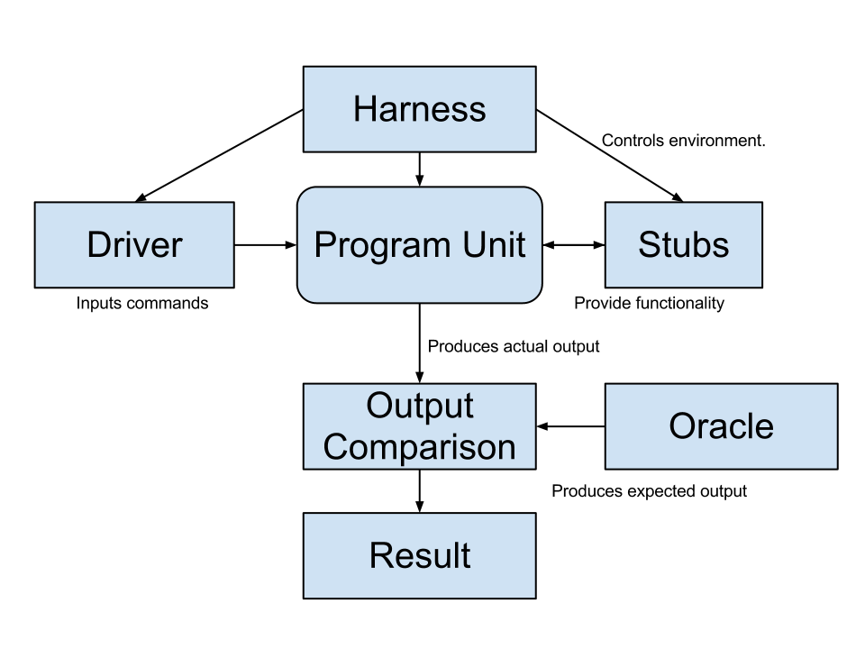
Test Scaffolding
Simulates the execution environment.
Can control network conditions, environmental factors, operating systems.
Templates that provide functionality and allow testing in isolation
Initializes objects
Initializes parameter variables
Performs the test
Performs any necessary cleanup steps.
Checks the correspondence between the produced and expected output and renders a test verdict.
Notes:
(click) Driver:A driver substitutes for a main or calling program. instantiates system objects, performs setup - initializes the non-local variables, initializes parameters, activates the test, then tears everything down when done. Called this because this is how you interact with the software and make it do something. Test cases are drivers.
They initializes objects and calls them, set up the oracle, and initiaes the result comparison once the test runs. (click) The harness simulates the execution environment. This usually comes into play when testing embedded systems - you might simulate the platform it is running on and the environment it’ll be used in if it needs to work with some particular environment - for instance, a pacemaker might need a simulated heart to react to. When testing a program with a networking component, you might simulate the network and try out different connection conditions. (click) Stubs (or mock objects) are templates that represent unimplemented or untested system components or external entities and allow you to test part of a system in isolation from the rest. (click)The oracle checks the produced output against an expected output and renders a test verdict - pass or fail. You might also need to write code for additional Support for recording and managing test execution.

Slide 29
Scaffolding
Mock objects and drivers are written as replacements for other parts of the system.
May be required if pieces of the system do not exist.
Scaffolding allows control over test execution and greater observability to judge test results.
Simulate dependencies and test components in isolation.
Ability to set up specialized testing scenarios.
Ability to replace part of the program with a version more suited to testing.
Notes:
(1). Sometimes stubs are needed to even make a component executable, if (2). Or, at least, we write them when we have dependencies that we don’t trust.
This temporary code, this scaffolding, (3), including giving us the ability to (4)- (5) (6) - say taking a protected component and replacing it with a version where you can freely read and check the correctness of fields.

Slide 30
Unit Testing - Object Mocking
Unit may depend on unfinished (or untested) components. Can mock those components.
Same interface as real component, but hand-created simulation.
Can be used to simulate abnormal operation or rare events.
Ex. Place exact data in database needed to hit special outcome.
WeatherData
temperature
windSpeed
windDirection
pressure
lastReadingTime
collect()
summarize(time)
Thermometer
ther_identifier
temperature
get()
shutdown()
restart()
Mock_Thermometer
ther_identifier
temperature
get()
shutdown()
restart()
get(){
return 98;
}
Notes:
I mentioned the idea of testing units in isolation a couple of times. The thing is that objects are often tightly interconnected, and when a problem occurs, it’s often hard to figure out where exactly the problem is coming from. Especially when parts of your system are closely linked with other objects. You might even have faults in both objects, and it only gets harder to isolate issues the more dependency links you have. If you are testing a method that depends on another methods, and that method depends on another method, you can see where this is going. It’s in your interest to try to test these units in as much isolation as is possible. Components may depend on other, unfinished (or untested) components. You can mock those components. Mock objects have the same interface as the real component, but are hand-created to simulate the real component. For instance, Your class might need to read from a non-existent database. your mocked database might only contain a couple of hand-written data items. Therefore, you do not need to depend on other components that may not be finished or may not have been satisfactorily tested. Mock objects are often used to substitute in data or results that you know are right, but they are also a cool tool for testing because - even if you do have that component working - you can create a mock object to simulate abnormal behavior or rare events, and make sure you hit those boundary cases.

Slide 31

Mocking Example
Declare a mock object: LinkedList mList = mock(LinkedList.class);
Specify method behavior: when(mList.get(0)).thenReturn(“first”);
Returns “first”: mList.get(0);
Returns null: mList.get(99);
Because behavior for “99” is not specified.
when(mList.get(anyInt()).thenReturn(“element”);
mList.get(0), mList.get(99) both return “element”, as all input are specified.

Slide 32
Mocking Within a Test
@test
public void temperatureTest(){
Thermometer mockTherm = mock(Thermometer.class);
when(mockTherm.get()).thenReturn(98);
WeatherData wData = new WeatherData();
wData.collect(mockTherm);
assertEquals(98, wData.temperature);
}
Notes:
Walk through

Slide 33
Let’s take a break.
Notes:
15 minute break

Slide 34
Build Systems
Notes:
In particular, build systems play a huge role in automating the compilation, testing, and packaging of software. You are writing make files in Miroslaw’s class, right? Well, that is a basic form of build system that we can expand on a bit.

Slide 35
Build Systems
Building, running tests, packaging and distributing are very common, effort-intensive tasks.
Building and deploying should be as easy as possible.
Build systems ease process by automating as much as possible.
Repetitive tasks can be automated and run at-will.
Notes:
Building software, running test cases, and packaging and distributing the executable are very common, effort-intensive tasks. So, The first goal of a new project is to make the process of building and deploying the project as easy as possible. Build systems ease this process by automating as much of it as possible. Repetitive tasks can be automated and run at-will., as we saw with unit testing

Slide 36
Build Systems
Allow control over code compilation, test execution, executable packaging, and deployment.
Script defines actions that can be automatically invoked at any time.
Many frameworks for build scripting.
Most popular for Java: Ant, Maven, Gradle.
Gradle very common for Android projects.
Notes:
Build systems (1) to production. We create a build script that descrives how to perform this process, then invoke elements of this script. There are many different frameworks for build scripting, including (last two)

Slide 37
Build Lifecycle
Validate
Compile
Test
Package
Verify
Install
Deploy
Validate the project is correct and all necessary information is available
Compile the source code of the project.
Test the source code using a suitable unit testing framework.
Unit tests and subsystem integration tests.
Take the compiled code and package it in its distributable format, such as a JAR.
Notes:
To see why this is a labor intense process when done by hand, it’s worth looking at what goes into a typical build. We can define a lifecycle of the build process, split into major stages. (seven stages, name them)
(go over)

Slide 38
Build Lifecycle
Validate
Compile
Test
Package
Verify
Install
Deploy
Verify - run system tests.
System tests require a packaged executable.
This is also when tests of non-functional criteria like performance are executed.
Install the package for use as a dependency in other projects locally.
Deploy the package to production environment.
Notes:
(go over)
These lifecycle phases (are executed sequentially. We will first validate the project, then will try to compile the sources, run tests against the compiled class files, package the binaries (e.g. jar), run system tests against that package, verify the tests, install the verified package to the local machine, then deploy the installed package to a remote repository or the production environment. Build systems allow you to execute any one stage or the whole lifecycle with a command.

Slide 39
Apache Ant
Simple build system for Java.
Build scripts define targets that can be executed on command.
Correspond to lifecycle phases or other automated tasks.
Targets can trigger other targets.
Build scripts written in XML.
Platform neutral, But can invoke platform-specific commands.
Human and machine readable.
Created automatically by many IDEs (Eclipse).
Notes:
Ant (Another Neat Tool) is a build system for Java where we create a build script that defines a set of targets that can be executed on command.
Targets can correspond to lifecycle phases or other desired automated tasks.
Targets can trigger other targets.
Build scripts written in XML.
Platform neutral, But can invoke platform-specific commands.
Human and machine readable.
Created automatically by many IDEs (Eclipse).

Slide 40
A Basic Build Script
<?xml version = "1.0"?> <project name = "Hello World Project" default = "info"> <target name = "info"> <echo>Hello World - Welcome to Apache Ant!</echo> </target> </project>
File typically named build.xml, and placed in the base directory of the project.
Build script requires project element and at least one target.
Project defines a name and a default target.
This target prints project information.
Echo prints information to the terminal.
Notes:
Typically, Ant's build file, called build.xml should reside in the base directory of the project. However there is no restriction on the file name or its location. You are free to use other file names or save the build file in some other location. That’s just a convention.All build files require the project element and at least one target element. (point out and go over)

Slide 41
Targets
<target name = "deploy" depends = "package"> .... </target> <target name = "package" depends = "clean,compile"> .... </target> <target name = "clean" > .... </target> <target name = "compile" > .... </target>
A target is a collection of tasks you want to run in a single unit.
Targets can depend on other targets.
Dependencies denoted using the depends attribute.
deploy will call package, which will call clean and compile.

Slide 42
Targets
<target name = "deploy" depends = "package"> .... </target> <target name = "package" depends = "clean,compile"> .... </target> <target name = "clean" > .... </target> <target name = "compile" > .... </target>
Target attributes:
name defines the name of the target (required)
depends lists dependencies of the target.
description is used to describe the target.
if and unless allow execution of the target to depend on a conditional attribute.
Execute target if attribute is true, or execute unless true.

Slide 43
Executing targets
<?xml version = "1.0"?> <project name = "Hello World Project" default = "info"> <target name = "info"> <echo>Hello World - Welcome to Apache Ant!</echo> </target> </project>
>> ant Buildfile: build.xml info: [echo] Hello World - Welcome to Apache Ant! BUILD SUCCESSFUL Total time: 0 seconds
In the command line, invoke:
ant <target name>
If no target is supplied, the default will be executed.
In this case, ant and ant info give same result because info is default target.

Slide 44
Properties
XML does not natively allow variable declaration.
Instead, create property elements, which can be referred to by name.
<?xml version = "1.0"?> <project name = "Hello World Project" default = "info"> <property name = "sitename" value = "http://cse.sc.edu"/> <target name = "info"> <echo>Apache Ant version is ${ant.version} - You are at ${sitename} </echo> </target> </project>
Notes:
(go over what the code does)

Slide 45
Properties
<?xml version = "1.0"?> <project name = "Hello World Project" default = "info"> <property name = "sitename" value = "http://cse.sc.edu"/> <target name = "info"> <echo>Apache Ant version is ${ant.version} - You are at ${sitename} </echo> </target> </project>
Properties have a name and a value.
Property value is referred to as ${property name}.
Ant pre-defines ant.version, ant.file (location of the build file), ant.project.name, ant.project.default-target.
Notes:
(go over what the code does)

Slide 46
Property Files
Can define static properties in a file.
Allows reuse of build file in different environments (development, testing, production).
Allows easy lookup of property values.
Called build.properties and stored in the same directory as build script.
Lists one property per line: <name> = <value>
Comments can be added using # <comment>
Notes:
Setting properties directly in the build file is fine, if you are working with a handful of properties. However, for a large project, it makes sense to store the properties in a separate property file. Storing the properties in a separate file offers benefits − It allows you to reuse the same build file, with different property settings for different execution environment. For example, build properties file can be maintained separately for DEV, TEST, and PROD environments. It is useful when you do not know the values for a property (in a particular environment) up-front. This allows you to perform the build in other environments where the property value is known. There is no hard and fast rule, but typically the property file is named build.properties and is placed along-side the build.xml file. You could create multiple build properties files based on the deployment environments - such as build.properties.dev and build.properties.test. The contents of the build property file are similar to the normal java property file. They contain one property per line. Each property is represented by a name and a value pair. The name and value pairs are separated by an equals (=) sign. It is highly recommended that the properties are annotated with proper comments. Comments are listed using the hash (#) character.

Slide 47
Property Files
build.xml
<?xml version = "1.0"?> <project name = "Hello World Project" default = "info"> <property file = "build.properties"/> <target name = "info"> <echo>You are at ${sitename}, version ${buildversion}.</echo> </target> </project>
build.properties
# The Site Name sitename = http://cse.sc.edu buildversion = 3.3.2

Slide 48
Conditions
Property value determined by and/or.
And requires that each property is true.
foo.txt and bar.txt must exist.
(available checks for file existence)
Or requires that 1+ properties true.
Calling myTarget.check creates property (myTarget.run), true if both files present.
When myTarget called, it will run only if myTarget.run is true.
<target name = "myTarget" depends = "myTarget.check" if = "myTarget.run"> .... </target> <target name = "myTarget.check"> <condition property = "myTarget.run"> <and> <available file = "foo.txt"/> <available file = "bar.txt"/> </and> </condition> </target>

Slide 49
Ant Utilities
Fileset generates list of files matching criteria for inclusion or exclusion.
** means that the file can be in any subdirectory.
* allows partial file name matches.
<fileset dir = "${src}" casesensitive = "yes"> <include name = "**/*.java"/> <exclude name = "**/*Stub*"/> </fileset>
Notes:
The fileset utility represents a collection of files. It is used as a filter to include or exclude files that match a particular pattern. For example. Here, the src attribute points to the source folder of the project. The fileset selects all .java files in the source folder except those contain the word 'Stub'. The case-sensitive filter is applied to the fileset which means a file with the name Samplestub.java will not be excluded from the fileset.

Slide 50
Ant Utilities
Path is used to represent a classpath.
pathelement is used to add items or other paths to the path.
<path id = "build.classpath.jar"> <pathelement path = "${env.J2EE_HOME}/j2ee.jar"/> <fileset dir = "lib"> <include name = "**/*.jar"/> </fileset> </path>
Notes:
The path data type is commonly used to represent a class-path. The classpath is set to the list of jar files and classes in the project, as shown in the example below.The attribute env.J2EE_HOME points to the environment variable J2EE_HOME. The attribute j2ee.jar points to the name of the J2EE jar file in the J2EE base folder.

Slide 51
Building a Project
<project name = "Hello-World" basedir = "." default = "build"> <property name = "src.dir" value = "src"/> <property name = "build.dir" value = "target"/> <path id = "master-classpath"> <fileset dir = "${src.dir}/lib"> <include name = "*.jar"/> </fileset> <pathelement path = "${build.dir}"/> </path> </project>
Properties src.dir and build.dir define where the source files are stored and where the built classes are deployed.
Path master-classpath includes all JAR files in the lib folder and all files in the build.dir folder.
Notes:
Let’s put all of this into action and talk about building a project.First, let us declare some properties for the source and build folders.src.dir refers to the source folder of the project where the java source files can be found. build.dir refers to the output folder of the project compilation. The master-classpath holds the classpath information. In this case, it includes the classes in the build folder and the jar files in the lib folder.

Slide 52
Building a Project
<project name = "Hello-World" basedir = "." default = "build">
<target name = "clean" description = "Clean output directories"> <delete> <fileset dir = "${build.dir}"> <include name = "**/*.class"/> </fileset> </delete> </target> </project>
The clean target is used to prepare for the build process by cleaning up any remnants of previous builds.
In this case, it deletes all compiled files (.class)
May also remove JAR files or other temporary artifacts that will be regenerated by the build.
Notes:
The clean target, as the name suggests, (go over)

Slide 53
Building a Project
<project name = "Hello-World" basedir = "." default = "build">
<target name = "build" description = "Compile source tree java files"> <mkdir dir = "${build.dir}"/> <javac destdir = "${build.dir}" source = "1.8" target = "1.8"> <src path = "${src.dir}"/> <classpath refid = "master-classpath"/> </javac> </target>
</project>
The build target will create the build directory, compile the source code (using javac), and place the class files in the build directory.
Can specify which java version to target (1.8).
Must reference the classpath to use during compilation.
Notes:
Finally, the build target to build the files. First of all, we create the build directory, if it does not exist. Then we execute the javac command (specifying jdk1.5 as our target compilation). We supply the source folder and the classpath to the javac task and ask it to drop the class files in the build folder. (go over code)

Slide 54
Creating a JAR File
The jar command creates executable from compiled classes.
<target name = "package"> <jar destfile = "lib/util.jar" basedir = "${build.dir}/classes" includes = "app/util/**" excludes = "**/Test.class"> <manifest><attribute name = "Main-Class" value = "com.util.Util"/></manifest> </jar> </target>
destfile is the location to place the JAR file.
basedir is the base directory of included files.
includes defines the files to include in the JAR.
excludes prevents certain files from being added.
The manifest declares metadata about the JAR.
Attribute Main-Class makes the JAR executable.
Notes:
(go over) The build.dir property in this example points to the build folder where the class files for the util.jar can be found. In this example, we create a jar file called util.jar using the classes from the app.util.* package. However, we are excluding the classes that end with the name Test. The output jar file will be placed in the lib folder.
If we want to make the util.jar an executable jar file we need to add the manifest - a set of metadata about the JAR - with the Main-Class attribute. To execute the jar task, wrap it inside a target, most commonly, the package target, and execute it. Running Ant package on this file creates the util.jar file for us.

Slide 55
Running Unit Tests
JUnit tests run using the junit command.
<target name = "test"> <junit haltonfailure = "true" haltonerror = "false" printsummary = "true" timeout = "5000"> <test name = "com.utils.UtilsTest"/> </junit> </target>
test entries list the test classes to execute.
haltonfailure / haltonerror will stop execution if tests fail/errors occur.
printsummary displays number of tests run, number of failures/errors, time elapsed.
timeout will stop and issue error if the time limit is exceeded.
Notes:
Ant makes it straight forward to run junit tests through the JUnit task. (go over)
Running ant test will run this test class and print the summary of results

Slide 56
We Have Learned
During system testing, we focus on interactions.
Test by calling methods or through an interface.
If thoroughly unit tested, failures due to interaction faults.
Mistaken assumptions, malformed calls.
Tests can focus on one “high-level” function or model full user journeys.

Slide 57
We Have Learned
Test automation can lower cost and improve the quality of testing.
Automation involves creating drivers, harnesses, stubs, and oracles.
Test cases written as executable code.
Additional support code (mocking, interface manipulation, wrappers for external dependencies) to enable testing.

Slide 58
We Have Learned
Testing is not all that can be automated.
Project compilation, installation, deployment, etc.
Project build automation:
Automating the entire compilation, testing, and deployment process.
Ant is an XML-based tool for automating build process.

Slide 59
Next Time
Exploratory Testing
Exercise Session: Unit Testing
(Follow instructions linked on Canvas to set up IDE)
Assignment 2 due Feb 15.

